Slide 1
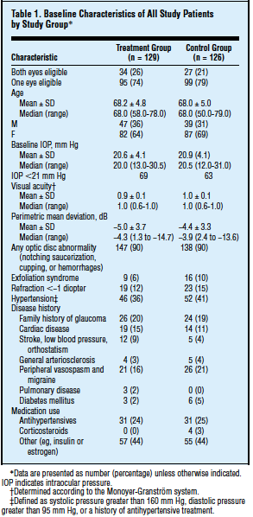

RTRS : R Tables for Regulatory Submissions Working Group https://github.com/RConsortium/rtrs-wg/
Creating standards to guide the development of R tools for creating tables that meet the requirements of the FDA and other regulatory agencies.
How to Help!
Send us examples of difficult tables
Join us!
Tables can make a submission

